Slide 1
Topographic instruments
Tripod
Plumb bob
Theodolite
Measuring tape
Calibrated stadia rod
Total Station
Telescope

Slide 2
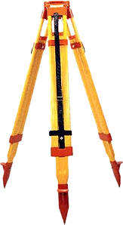
TRIPOD
The tripod is an accessory that support a topographic instrument, in particular theodolite and total station.
It is formed by three telescopic legs that raise the instrument by the floor level.
It’s used for give at the instrument a horizontal surface on which laid.

Slide 3
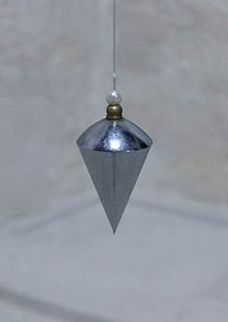
PLUMB BOB
In antiquity to trace a vertical line were used the plumb bob, but today this is an obsolete instrument.
It is formed by a line with a mass on the termination.

Slide 4
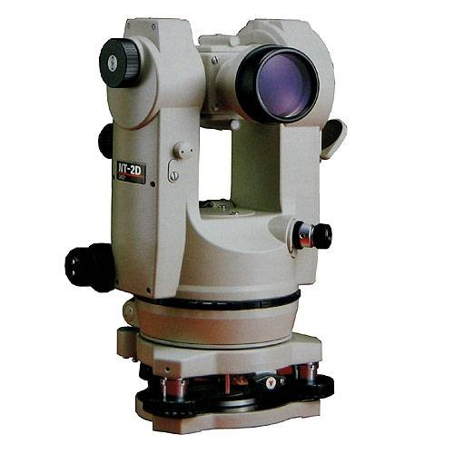
THEODOLITE
This optical-mechanical topographic instrument is formed by a telescope, two graduated circle, alidade, two types of bubble level, three leveling screws and a lent at 45° that give us a 90° view on the floor that replaces the antiquated plumb bob.
The main task of this instrument is to calculate the vertical and orizzontal angles.

Slide 5
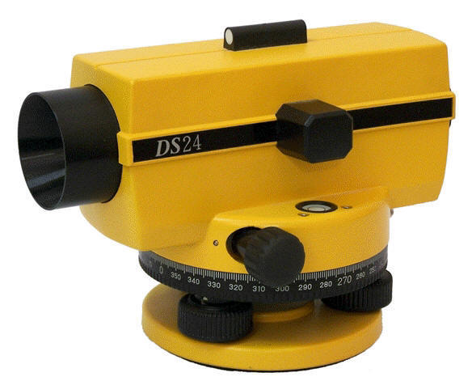
TELESCOPE
The telescope is formed by a system of lents and it is used to magnify a point at a certain distance. In the instrument there is a view finder tha is used for direct the crosshair at the center of the point that we want collimate.

Slide 6
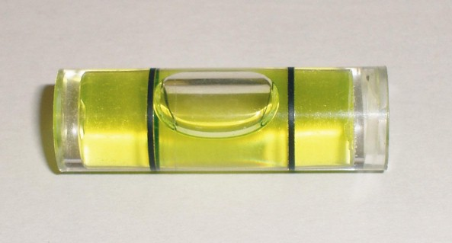
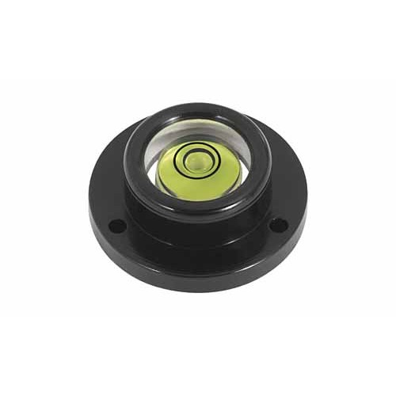
LEVEL
There are two types of bubble level:
- Sferic level
- Plate level

Slide 7
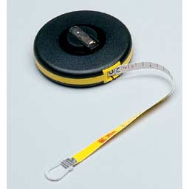
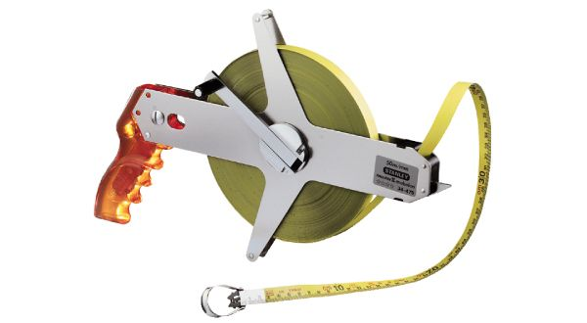
MEASURING TAPE
To calculate a distance, in association with the theodolite we use the measuring tape.
It is formed by a calibrated tape.

Slide 8
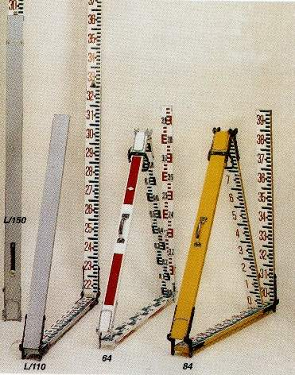
CALIBRATED STADIA ROD
The calibrated stadia rod is an instrument with a sensibility at the tenth of a millimeter that is used for determine the height of a point.

Slide 9
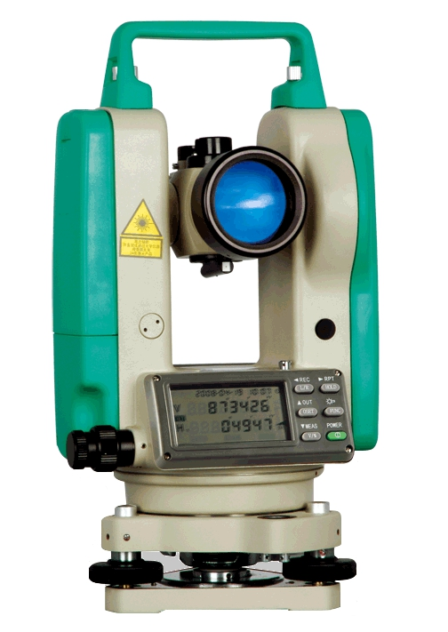
TOTAL STATION
Total station is an electronic theodolite that can also calculate the distance between the instrument and a selected point. New generation of this instrument can be incorporated with a GPS.

Slide 10
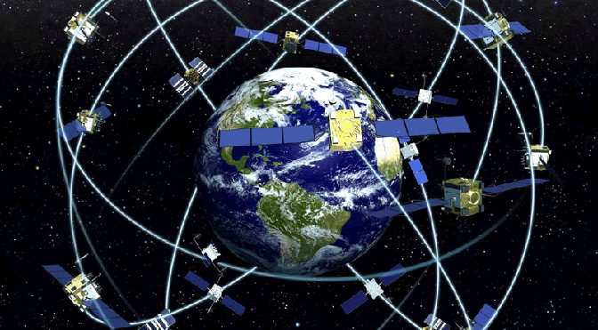
GPS
GPS is an acronym of Global Position System and have a lot of applications.
In association whith the electronic total station it is a technique for determining position and elevation on earth.
It uses satellites placed into orbit to triangolate the point.

