Slide 1
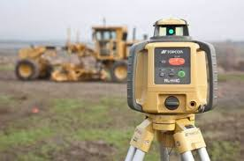
Surveying instruments
Surveying instruments are used by experts to make measurements of the Earth surface, both angles and distances.

Slide 2
Tripod
It is a mechanic instrument which acts as a support formed by three shortening and extensible legs; it is used to elevate the instrument from the ground

Slide 3
Measuring tape
It consists of a ribbon of plastic or fiber glass with linear-measurement markings. Its design allows for a measure of great length. It is flexible and so it is possible to measure around curves or corners.

Slide 4
Calibrated stadia rod
A telescope instruments having two parallel lines through which intervals on a calibrated rod are observed.
It is commonly used to measure distances

Slide 5
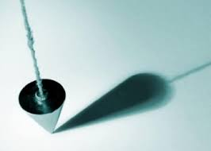
Plumb-bob
A plumb-bob is a weight suspended from a string and used as a vertical reference line, or plumb-line.
However this instrument isn’t used anymore because it has been replaced by more modern instruments.

Slide 6
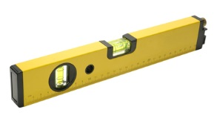
Level
An instrument for ascertaining whether a surface is horizontal, vertical, or at a 45° angles.
It essentially consists of a liquid-filled tube containing an air bubble.
When it is in the middle of the tube, the surface is flat (horizontally, vertically or at 45°).

Slide 7
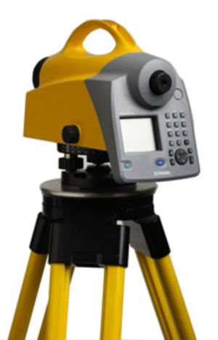
Different types of levels
A surveyor’s level is an instument consisting of a revolving telescope mounted on a tripod. It is used for finding points of identical height.
An automatic digital level is a new kind of technology which offers direct electronic reading and data storage using barcode reading equipment thanks to which trascription errors are eliminated.
New digital levels also have a large internal memory thanks to which measurements are simple, quick and efficient. This instruments can also be used in low light conditions.

Slide 8
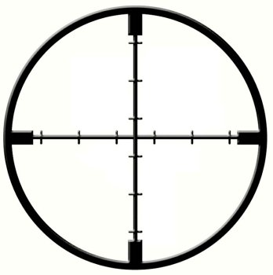
Crosshair
It is the most commonly used reticle, formed by a net of fine lines in the eyepiece, like a telescope.
It is used to center a point.

Slide 9
Theodolite and Telescope
The theodolite is a surveying instrument for measuring horizontal and vertical angles. It consists of a small tripod-mounted telescope, that is free to move in both the horizontal and vertical planes.
So the telescope is the optical part of the theodolite. Since it has an internal crosshair, it is useful to center the point.

Slide 10
Total station
First of all we can say that it is a particular instrument because it is formed by the set of the theodolite and an electronic distance meter; infact it is able to measure angles and distances at the same time .

Slide 11
GPS Total station
GPS total station is the newest innovation in total stations., because it rceives signals from satellites placed into orbit. The most important advantage is that this tecnology is able to make the whole process of surveying very quickly and easily because it has efficent features. So it is a very sophisticated system, but it is very expensive and it can’t accede in particular points.

Slide 12
Presentazione a cura di:
Cirasola Felice
Carlucci Pasquale
Tarantino Vincenzo
Classe 4°A Data:17/10/2014

