Slide 1
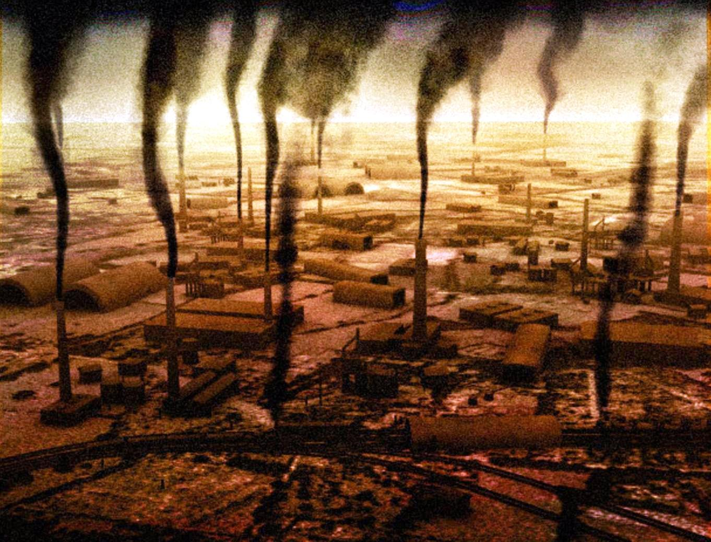
POLLUTION
Casiello Francesco
Ardino Nicola
Dimola Nicola
Vito Ferrulli

Slide 2
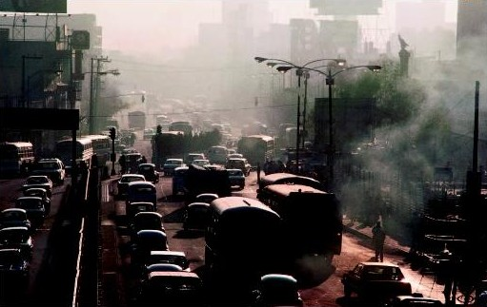
POLLUTION GENERAL
Pollution is the introduction of contaminants into the natural environment that cause adverse change. Pollution can take the form of chemical substances or energy, such as noise, heat or light. Pollutants, the components of pollution, can be either foreign substances/energies or naturally occurring contaminants. Pollution is often classed as point source or nonpoint source pollution.
Continued

Slide 3
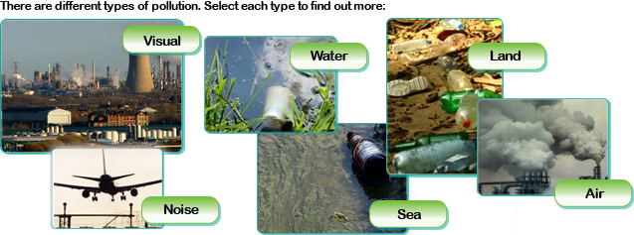
There are different types of pollution:
Air pollution
Light pollution
Noise pollution
Soil contamination
Radioactive contamination
Visual pollution
Water pollution

Slide 4
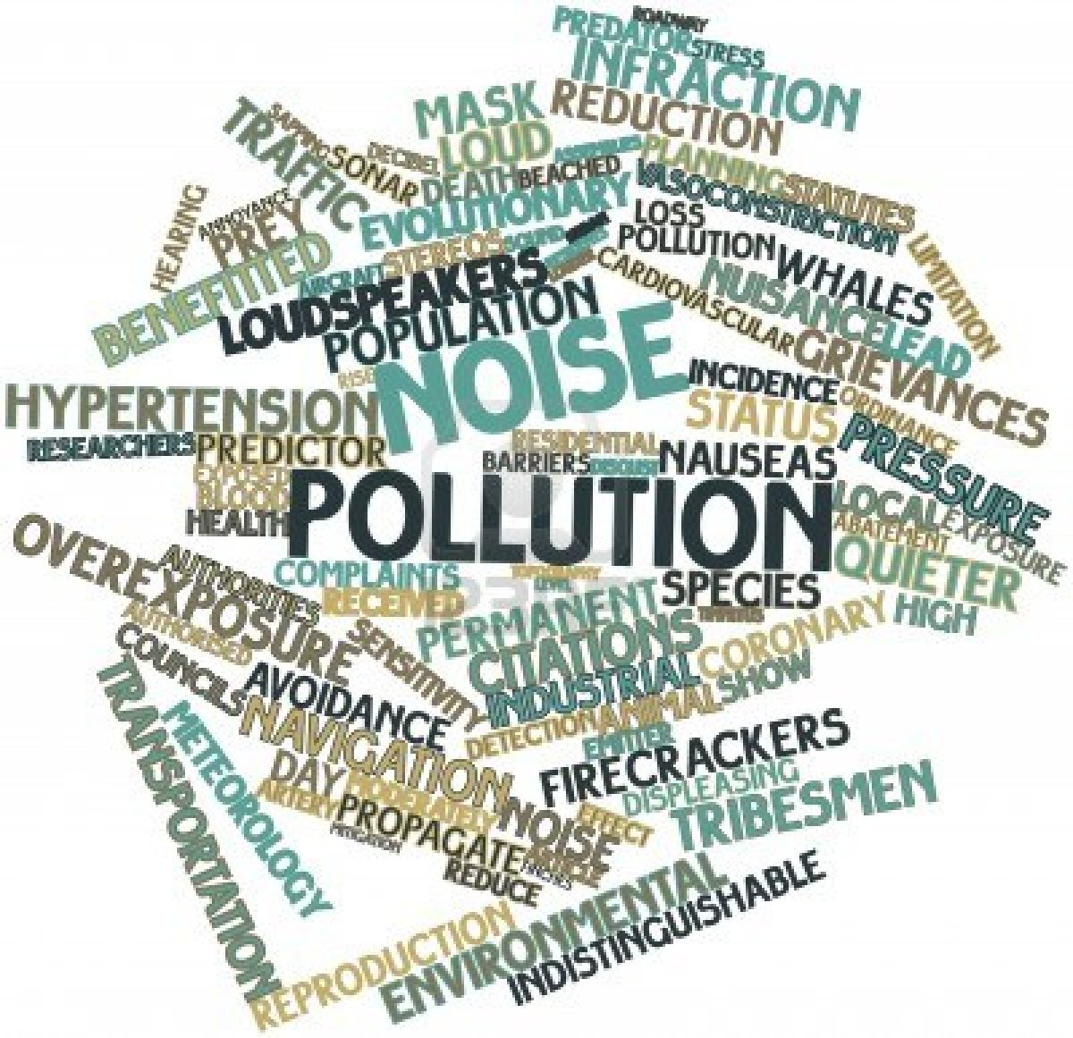
NOISE POLLUTION
GENERAL CONSIDERATIONS
For noise is defined as excessive exposure to a high pitch sound, such as to cause discomfort disorders to human life, health, and also to the ecosystem.
EFFECTS
CAUSES
SOLUTIONS

Slide 5
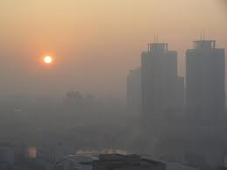
CAUSES
Noise pollution, over the years has become one of the major problems of environmental pollution, resulting in psychological problems, sleep disorders and stress.
The main causes of noise pollution are: factories, industries, shipyards, horn, clubs, aircraft, etc..
Urban traffic and transportation with cars and trucks is the main cause of noise pollution in the world.

Slide 6
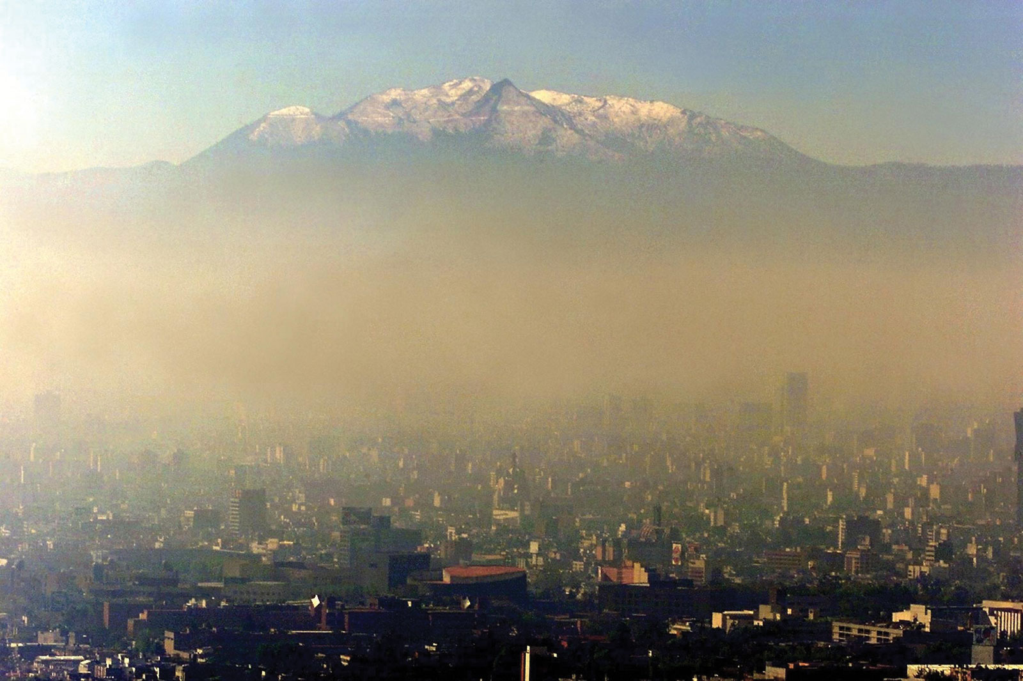
EFFECTS
The effects are many and can lead to hearing damage, health, sleep and even at work.
The damage from noise depends on the level of sound that does not exceed 20,000 Hz
Noise pollution causes especially trauma and ear damage so as to cause hearing loss.
Disturbance and annoyance are two other diseases that affect the psyche of the people leading to stress and nervous system problems.
Even in the workplace noise is due to injuries and stress, so that there are laws that protect the health of workers from these damages.

Slide 7
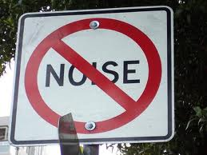
SOLUTIONS
The remedies that can reduce noise pollution are:
build vehicles with low acoustic noise, build buildings from noise sources or install noise barriers.
In addition to reducing the problem you have to limit the volume of the sound, protect yourself with either headphones or mount the housing with double glazed windows.

